Slide 1
VXINYOU SDK TECHNOLOGY INTRODUCTION FOR ANDROID SYSTEM
Time Box

Slide 2
Catalogue
·Catalogue
· Summary
· Necessary Interfaces
· Important Notice
· Login Process
· 2.2 Preparation before interfaces
· 2.3 Introduction for Interfaces
· 2.3.1 Login interfaces--obtain authorization code, application client server calls.
· 2.3.2 Obtain access-token--Interface of the server, application server calls.
· 2.3.3 Refresh access-token, Interface of the server, application server calls.
· 2.3.4 Check access-token-Interface of the server.
· 2.3.5 Obtain customer info. -- Interface of the server, application server calls.
· Exit the interfaces
· 3.1 Exit the interfaces-VXINYOU SDK interfaces, application server calls
· Payment Process
· 4.1 Introduction for payment process
· 4.2 Introduction for Interfaces
· 4.2.1 Obtain bill no.- application server or application client server calls
· 4.2.2 Payment interfaces- VXINYOU SDK interfaces, application client server calls
· 4.2.3 Inform the third party of the consume debit synchronization(exclude with no server)
· 4.2.4 Obtain synchronization inform server of the failure data. (exclude with no server)
· 4.2.5 Monitor consume debit for console game. (exclude with occupied server )
· Transcribe Voices
· 5.1 Transcribe voices service- application client server calls
· Additional Notice
· OAuth 2.0 Theory for Identification & Authorization

Slide 3

Summary
Summary
  This document describes Android mobile phone applications access to a platform through an open platform .Open platform serves the login service and payment services for Android applications.
  Besides, it is for the developer of Android applications developers, including the client server engineers and server engineers.
All interfaces to login(exclude with no server);
All interfaces to payment;
Notice for Login & Exit games.

Slide 4
1.2 Important Notice
  1.Android version must be up 4.0, below 4.0 can not support game-pad function. USB game-pad function can well matched with OTG function which device has itself.
  2. Must import vxinyouandroidsdk.jar, otherwise couldn’t use Vxinyou related interfaces, please pay attention all requested parameter need lowercase.
  3. Pls do not obfuscate below class if you need to obfuscate java code. You can add below class to proguard configuration, exclude the obfuscation:
  -keep class com.vxinyou.box.sdk.**{*;}
  -keep class com.vxinyou.box.tools.**{*;}
  4. One appid deserves one application, one appid only be dispatched to one application. More apps use one appid can cause non-correct charge & effect income, and, furthermore, it will lead to failure of SDK upgrade, incorrectness for statistical data, influenced hardly for developer income & user experience finally. You need to add appid to configuration document - AndroidManifest.xml
  <meta-data
  android:name="VXINYOU_APPID"
  android:value="94ea6f1b-51cb-417b-a52d-4a33726fb0fe" />
5. For safety, appkey can not be written into cell-phone apps, only be kept on application server, in case decompiled cell-phone application get this info. Appkey will reveal info.of imitative successful payment, lead to the both sides losses.

Slide 5
6.Considering of the safety for access token, limited time controls within 10hours. If beyond, New token will be replaced through refresh token, valid time of authorization code is 20seconds.
7.In order to achieve perfect effect, the third party of game should be accept the event for game-pad button call and adapt to different resolution for devices, the minimum should be 720p and maximum is 1080p.
8.In case of missing data after players formatting device (especially console game), the supplier need to tell V XINYOU about the path of archive file, so it is convenient to find back the missed data.
*This document faces to the developer of Android applications, including the client server engineers and server engineers
The console game exclude no server has no necessary to call login process, only to call payment interfaces and login notice, and notice when exiting.
If no server, please add below to configuration document AndroidManifest.xml
<meta-data
android:name="VXINYOU_STAND_ALONE_VER"
android:value="yes" />

Slide 6
Login Process (Please ignore with no server)
Android application could gain access token of current user through login authorization process, then gain the login information for current user, eg : users ID, after that, application can link to the payment system of VXINYOU.
Login process of Open platform for VXINYOU use OAUTH2 agreement standard authorization process, customer should be well kept and use the access-token(gain user info., payment and such API) and refresh-token (refresh access-token)which gain it through VXINYOU open platform.
Tips: New token will be achieved when users login again, and the former one invalid. It means if customers login the same game use same ID in different devices, only the last login token is available, and the formers ID will be failed when call VXINYOU interfaces.
Login process- use authorization code to gain access token
Sequence Diagram as below,

Slide 7
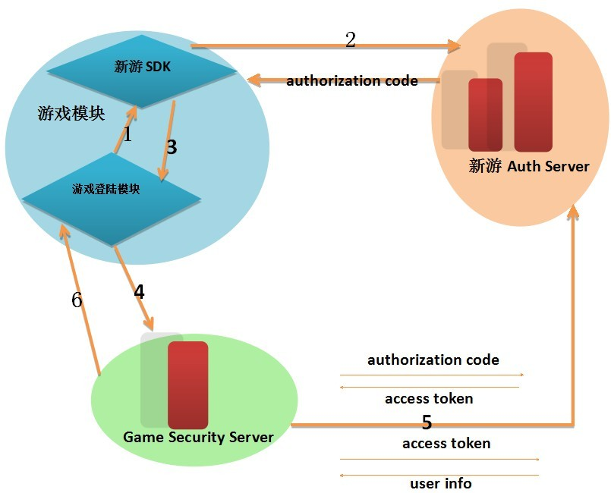
1.Game login module call SDK to login.(2.3.1)
2. SDK communicate with VXINYOU Auth Server to login, back to authorization code.
3. SDK returns authorization code to game login module.
4. Game login module return authorization code to Game Security Server of developer.
5. Game Security Server of CP issue request to Auth Server, and gain access token.
a.Use authorization code to gain access token.(2.3.2)
b. Issue request for user info by using access token.(2.3.5)
6. Game Security Server finish login game ID, application client server goes into game process through server, use authorization code to gain access token. Based on this, application service issue a request to VXINYOU server through HTTP agreement, the safety is better, app_secret kept on the application server alsocan not leak out.
Considering of the safety for access token, limited time controls within 10hours. If beyond, new token will be replaced through refresh token. There is only one availbale access token, the process of exchanging follows 2.3.3

Slide 8
2.2 接入前准备
2.2 Preparation Before Interfaces
Lay in vxinyouandroidsdk.jar package and boxclientcommon.jar package, please copy jar package to lib album.
appid={application id}
appkey = {game key}
time={current time}
md5key=md5(appid + time + appkey)
Notice：appkey do not save in the client server, time should be kept same between “time”& “md5key”, otherwise can not catch data. All interfaces returns json form data, rstate value as below:
0=success other value means failure
-1 = md5key(md5) verify failure,
-2 = login mark invalid,
-3 = authorization code invalid,
-4 = token expire
-5 = token invalid
-7 =server unusual
-8 = failure

Slide 9
2.3 接口介绍
2.3 Introduction For Interfaces
2.3.1 Login interfaces--obtain authorization code, application client server call.
Function Introduction:
security process, application call VXINYOU SDK login interfaces, VXINYOU SDK login page, user login and and authorization. VXINYOU back to authorization code after successful login every time, application use authorization code and request application server to gain access token info.(access token is a necessary ID verify parameter when carry on payment and etc.)
Succeeded log in will back to results, failed login will give a tip and hold on the login page, unless users press back button to cancel.
Interfaces form:public LoginResult login(long time, String checkkey)
Request parameter:
parameter | type | necessary or not | parameter description
time | long | Yes | current time
md5key | String | yes | md5key=md5(appid + time + appkey)
appkey | String | yes | activation key
Return parameter:
parameter | type | parameter description
rstate | int | 0 means successful，the rest means failed (-1,-2,-7)
code | String | the valid time for abtaining authorization Code
rmsg | String | description for error

Slide 10
2.3.2 获取access token–服务器端接口, 应用服务器调用
2.3.2 Obtain access-token--Interface of the server, application server call.
Notice: Do not issue a request from client server, otherwise appkey will leak out.
Application gain authorization code from the return call from VXINYOU login interfaces, and authorization code need to exchange access token. Application send authorization code to server, access token gained from /oauth2/access_token of VXINYOU server that application server send.
Parameter state:
参数 | 参数类型 | 是否必填 | 参数说明
appid | String | 是 | 应用
authorization | String | 是 | 通过新游
time | long | 是 | 当前时间
md5key | String | 是 | md5( "get_token" + authorization + time + appkey)
For example：
http://115.236.20.170:8080/tvbox/cmd/sdk/get/token? appid=083051da-d0e8-41cb-9065-9740e88741f8&authorization=1&time=1388737408283&md5key=0c16a452e5bde229af3d920e917badc3

Slide 11
Return parameter:
:
参数 | 参数类型 | 参数说明
endtime | long | expiration time for access Token
code | String | the valid time for visiting access token is 20s
rstate | int | 0 stands for sucessful ，the rest means failed(-1,-3)
rmsg | String | the message for losing access token
Return example：
If md5key=0c16a452e5bde229af3d920e917badc3 means successful
request url：
http://115.236.20.170:8080/tvtest/cmd/sdk/get/token? appid=083051da-d0e8-41cb-9065-9740e88741f8&authorization=1&time=1388737408283&md5key=0c16a452e5bde229af3d920e917badc3
successful {"data":{"endtime":"10","code":"authorization code"},"rstate":"0"}

Slide 12
Client server example:
private static final int WHAT_LOGIN = 1;
//ask for obtaining authorization code
btnTest.setOnClickListener(new OnClickListener() {//login
@Override
public void onClick(View arg0) {
Thread mThread = new Thread() {
@Override
public void run() {
VxinyouLogin mVxinyouLogin = new VxinyouLogin(MainActivity.this);
long time = System.currentTimeMillis();//the time needs to be coincide with the time of checkkey，otherwise it cannot get data.
String appid = SystemManage.getApplicationMetaData(MainActivity.this,"VXINYOU_APPID");
String appkey = "12345678";
String checkKey = BaseUtil.MD5(appid + time + appkey);
LoginResult mLoginResult = mVxinyouLogin.login(time,checkKey);
Log.i(TAG, "the request returns back");
if (mLoginResult != null) {
Log.i(TAG, "mLoginResult.authorizationCode:"+mLoginResult.authorizationCode);
Message msg = new Message();
msg.obj = mLoginResult;
msg.what = WHAT_LOGIN;
mHandler.sendMessage(msg);
}
}
};
mThread.start();
}
});

Slide 13
2.3.3 刷新access token–服务器端接口, 应用服务器调用
2.3.3 Refresh access-token, Interface of the server, application server call
Request Parameter:
parameter | type | neccessary or not | description
appid | String | yes | id for application
token | String | yes | used for refresh old token
time | long | yes | current time
md5key | String | yes | md5key={md5( "change_token" + token+time + appkey)
Request example:
http://115.236.20.170:8080/tvtest/cmd/sdk/change/token? appid=083051da-d0e8-41cb-9065-9740e88741f8&token=1&time=1388737408283&md5key=0c16a452e5bde229af3d920e917badc3
Return Parameter:
parameter | type | description
rstate | int | 0 means successful，the rest means failed (-1,-4)
code | String | the refreshed access token
endtime | String | expire time for access token
rmsg | String | description for error message
Return example:
If md5key=0c16a452e5bde229af3d920e917badc3 means successful，the rest are failed
Request url:
http://115.236.20.170:8080/tvbox/cmd/sdk/change/token? appid=083051da-d0e8-41cb-9065-9740e88741f8&token=1&time=1388737408283&md5key=0c16a452e5bde229af3d920e917badc3
successful {"data":{"endtime":"10","code":"random code"},"rstate":"0"}

Slide 14
2.3.4 Check access-token-Interface of the server.
2.3.4 校验access token–服务器端接口,应用服务器调用
Request Parameter:
Parameter | type | neccessary or not | description
appid | String | yes | application
token | String | yes | Access Token
time | long | yes | current time
md5key | String | yes | md5key={md5("check_token"+ token+ time + appkey)
Request Example:
http://115.236.20.170:8080/tvbox/cmd/sdk/check/token?appid=083051da-d0e8-41cb-9065-9740e88741f8&token=1&time=1388737408283&md5key=0c16a452e5bde229af3d920e917badc3
Return Parameter:
Parameter | type | description
rstate | int | 0 means successful ,the rest means failed (-1,-4,-5)
code | String | access token
endtime | String | expire time of access token
rmsg | String | error message for

Slide 15
2.3.5 Obtain customer info. -- Interface of the server, application server call.
2.3.5 获取用户信息–服务器端接口,应用服务器调用
Request Parameter:
parameter | type | neccessary or not | description
appid | String | yes | application
token | String | yes | access token
time | long | yes | current time
md5key | String | yes | md5key={md5("get_userinfo" + token+time + appkey)
Request Example:
http://115.236.20.170:8080/tvbox/cmd/sdk/get/userinfo?appid=083051da-d0e8-41cb-9065-9740e88741f8&token=1&time=1388737408283&md5key=0c16a452e5bde229af3d920e917badc3
Return Parameter:
parameter | type | description
rstate | int | 0 means successful，the rest means failed(-1,-4,-5)
id | String | player id
name | String | player name
sex | String | player sex
rmsg | String | error message for failed

Slide 16
Login and Exit Game Call
3.1 Login and exit game call- Application client server call
/** Running games call, notice platform make log **/
private void startApp() {
VxinyouLog mVxinyouLog = new VxinyouLog(this);
mVxinyouLog.startApp();
}
/**Close games call, exit whole game, notice platform make log **/
private void exitApp() {
VxinyouLog mVxinyouLog = new VxinyouLog(this);
mVxinyouLog.exitApp();
}

Slide 17
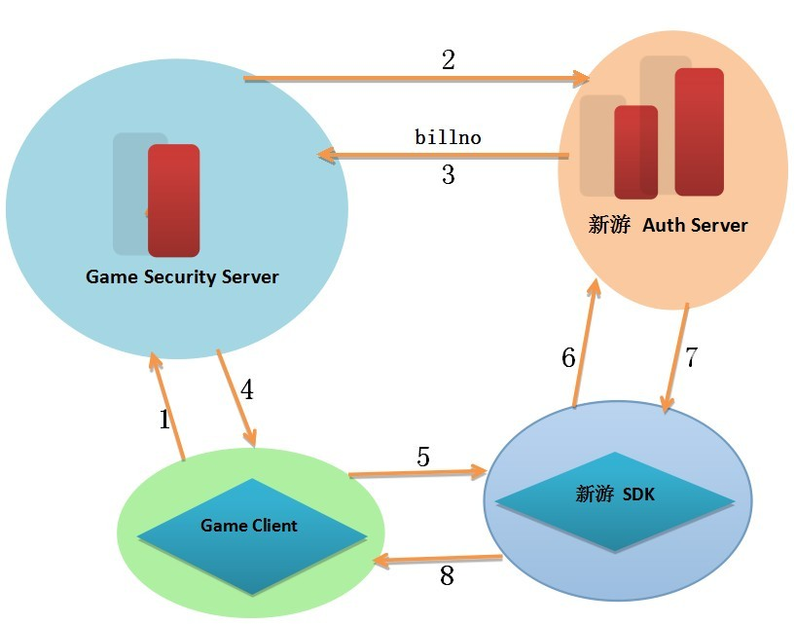
支付流程
Payment Process
4.1 Introduction for payment process
Sequence Diagram as below,
1. Game Client issue a request to Game Security Server
2. Game Security Server communicate with VXINYOU Auth Server to issue a request for billno
3. VXINYOU Auth Server return billno to Game Security Server
4. Game Security Server return billno to Game Client
5. Game Client call VXINYOU SDK payment interfaces( 4.2.2 )
6. VXINYOU SDK communicate with Auth Server to operate payment.
7. VXINYOU Auth Server return payment result to VXINYOU SDK payment interfaces
8. VXINYOU SDK payment interfaces return result to Game Client

Slide 18
4.2 Introduction for Interfaces
4.2.1 Obtain bill no.- application server call
（ignore if no server）
Notice: appkey value should gain from the third server, and for safety, please do not save in client server. Time for mPay.time should be same with time for checkKey, otherwise can not get data.
Notifyurl: If the third party provide a notice address: http://www.xxx.com, if payment successes, VXINYOU will return result to the page of http://www.xxx.com asynchronous.
Syscurrencytype: type of currency, type of currency involves the third party income, and it need confirmed in advance.
Request parameter: Value of Non-mandatory can be null.
Console game with no server does not need request billno,
billno can be gained asynchronous notification.
parameter | type | neccessary or not | description
appid | String | yes | the ID for game
appname | String | × | game name
appserverid | String | yes | game server
appservername | String | × | server name
correlationno | String | yes | billing number（from third-party）cannot be repeated
createtime | long | yes | the building time of bill no.
validtime | long | yes | thevalid time of bill no.
userid | String | yes | uer id on platform
appuserid | String | × | user id in game
appusername | String | × | user name of a game
notifyurl | String | × | notification for successful payment
prcid | String | × | Consumption item no.

Slide 19
prcname | String | × | Consumption item no
amt | float | yes | amount，RMB,accurate to two decimal point
accesstoken | String | yes | 令牌
ext1 | String | × | expansion message
ext2 | String | × | expansion message
currenttype | int | yes | Currency type（ just RMB）
syscurrencytype | int | yes | 1:net silver online payment，Game Currency（不支持平台货币和平台赠送货币） 2支持平台货币但不支持平台赠送货币） 3支持平台赠送货币也支持平台货币
checkkey | String | yes | ={md5( accesstoken + correlationno + amt +cratetime + appkey )}
Encoding is utf-8， notifyurl if any value, set URLEncoder.encode(notifyurl);encoding
Request Example：
http://115.236.20.170:8080/tvbox/cmd/sdk/trade/app/bill?userid=08da76f2-1889-471f-ba8f-be1f358b7471&appid=446051ee-c710-47c7-a595-6ee3fd3e3124&appname=app1&appserverid=server1&appservername=sersver1&correlationno=456789&createtime=1389584864161&validtime=1389584872743&appuserid=appuserii111101&notifyurl=http%3A%2F%2Ftest001.com&prcid=pri11&prcname=priname001&amt=20&syscurrencytype=1&accesstoken=786a28b0-7494-41d8-9138-6d460000c1db&checkkey=2b91ff43e3d9c061f2c034eaa8de0ee4&currenttype=1

Slide 20
4.2.2 Payment interfaces- VXINYOU SDK interfaces, application client server call
Return Parameter:
参数 | type | description
rstate | int | rstate=0 （，-4，-5，-8）
billno | String | bill no.
correlationno | String | bill no. from third-party
rmsg | String | error description
successful {"rstate":0,"data":{"billno":"单据号","correlationno":"bill no. from third-party"}}
incorrect {"rstate":错误码（-1 -4 -5 -8）, "rmsg":"错误描述"}
Request parameter: Value of Non-mandatory can be null.
parameter | type | neccessary or not | 参数说明
billno | String | × | bill no.（for single game, it can be null）
payamt | float | yes | payment amount，RMB, accurate to two decimal point
appname | String | × | game name
appserverid | String | yes | server id of a game（it is neccessary for online game，for single game, it can be null）
appservername | String | × | server name of game

Slide 21
Interfaces format:
public PayResult pay(String pay)
Client server code example：
class Pay {
public String billno;//
public float payamt;// {payment amount should accurate to two decimal point} Mandatory fields}
public String appname;// {game name}
public String appserverid;// server id is mandatory
public String appservername;// {server name
}
Thread thread = new Thread() {
public void run() {
VxinyouPay mVxinyouPay = new VxinyouPay(MainActivity.this);
Pay mPay = new Pay();
mPay.billno = "no0001";
mPay.appname = "game 1";
mPay.appserverid = "1";
mPay.appservername = "service1";
Gson mGson = new Gson();
String payJson = mGson.toJson(mPay);
PayResult mPayResult = mVxinyouPay.pay(payJson);
Message msg = new Message();
msg.obj = mPayResult;
msg.what = WHAT_PAY;
mHandler.sendMessage(msg);
}
};
/**return mesaage for whether the request is successful */
case WHAT_PAY:
obj = msg.obj;
if (obj instanceof PayResult) {
PayResult mPayResult = (PayResult) obj;
tvResult.setText("rmsg:" + mPayResult.message+ " status:" + mPayResult.status);
}
break;

Slide 22
Return Parameter:
parameter | type | description
rstate | int | result：0=successful，the rest=failed
rmsg | String | error description
4.2.3 Inform the third party of the consume debit synchronization (exclude with no server)
If the third party provide a notice address: http://www.xxx.com, if payment successes, VXINYOU will return result to the page of http://www.xxx.com asynchronous.
Return parameter:
参数 | 参数类型 | 参数说明
rstate | int | result：0=successful，rest=failed
checkKey | String | md5(billno + amt + time + appkey )
appid | String | the id for game
appserverid | String | game server
billno | String | bill no cannot be repeated
correlationno | String | bill no from third party
time | long | payment time
userid | String | user id on platform
appuserid | String | user id for game
appusername | String | user name in game
amt | float | payment amount should accurate to two decimal point

Slide 23
currenttype | int | 货币类型1:游戏货币（不支持平台货币和平台赠送货币） 2支持平台货币但不支持平台赠送货币） 3支持平台赠送货币也支持平台货币
prcid | String | Consumption item no.
prcname | String | Consumption item name
paytype | int | 充值方式 31:支付宝无线快捷充值 32:支付宝网页充值 33:微信充值 34:中国网银 35:快钱 36:微博充值 37:平台钱包充值 38:平台赠送钱包充值
billtype | String | the bill type that bulit by Xinyou
Example of successive return:
{"checkKey":"38dc8b9bb6de39ed1a208da0b5dc3427","data":{"amt":0.01,"billtype":1,"time":1392262093000,"appusername":"测试用户","paytype":32,"userid":"ca1b6504-d626-4d58-b6dd-4cb3f7e15d02","appid":"d6a154e3-49a2-45af-ae93-16784ab0bb13","appserverid":"4","billno":"5285737a-a7eb-4823-87dd-cd6cc859d11e"},"rstate":0}
Notice: correlationno，appuserid，appusername，prcid，prcname these parameter might be null, others will not be null.
Get success value is sent successfully, otherwise sent notification repeatly.( test failed will send notification every two minutes, total two times)
Notifyparam parameter processing URLEncoder.encode(notifyparam);encoding need URLDecoder.decode(notifyparam) decoding

Slide 24
4.2.4获取异步通知服务器失败数据(没服务器的可忽略)
4.2.4 Obtain synchronization inform server of the failure data. (exclude with no server)
Request parmeter:
parmeter: | type | necessary or not | 参数说明
appid | String | yes | id for a game
appserverid | String | yes | game server
month | String | yes | Equiry month
md5key | long | yes | {md5(appid+ month + appkey)
Function state: the request will gain all failed notification information, appserverid can be null(null can check the signed month of games asynchronous notification failure data),others parameter can not be null.
Request example：
http://115.236.20.170:8080/tvbox/cmd/sdk/trade/inform/fail/data?appid=94ea6f1b-51cb-417b-a52d-4a33726fb0fe&appserverid=&month=3&md5key=f6706770bcd87d2f044c3a2aa36e9907
Return example:
{"data":[{"amt":0.01,"time":1393041027000,"prcid":"pri11","appuserid":"appuserii111101","userid":"1ea567dd-551d-4f18-b649-f71583d35fe2","appid":"94ea6f1b-51cb-417b-a52d-4a33726fb0fe","prcname":"priname001","appserverid":"server1","billno":"6762f6e0-df3b-4ea7-a33b-1e80502d0e1a","currenttype":1},{"amt":0.01,"time":1393041773000,"prcid":"pri11","appuserid":"appuse
rii111101","userid":"1ea567dd-551d-4f18-b649-f71583d35fe2","appid":"94ea6f1b-51cb-417b-a52d-4a33726fb0fe","prcname":"priname001","appserverid":"server1","billno":"a902271d-f8d2-45e8-b023-1b676cf9ec99","currenttype":1}],"rstate":0}

Slide 25
Return Parameter:
参数 | 参数类型 | 参数说明
rstate | int | 结果：0为成功，其余失败
appid | String | 分配给游戏的唯一
appserverid | String | 游戏服务器
billno | String | 单据号，不可重复
correlationno | String | 第三方游戏产生的单据号
time | long | 时间
userid | String | 平台用户id
appuserid | String | 游戏用户id
appusername | String | 游戏的用户名称
amt | float | 金额，单位为元RMB,精确两位小数点
currenttype | int | 货币类型1:游戏货币（不支持平台货币和平台赠送货币） 2支持平台货币但不支持平台赠送货币） 3支持平台赠送货币也支持平台货币
prcid | String | 消费项目编号
prcname | String | 消费项目名称
paytype | int | 充值方式 31:支付宝无线快捷充值 32:支付宝网页充值 33:微信充值 34:中国网银 35:快钱 36:微博充值 37:平台钱包充值 38:平台赠送钱包充值
billtype | String | 单据类型 新游平台创建的
rmsg | String | 如果失败，错误描述信息

Slide 26
4.2.5 Monitor consume debit for console game. (exclude with occupied server )
Return parameter:
参数 | 参数类型 | 参数说明
appid | String | 分配给游戏的唯一
appserverid | String | 游戏服务器
billno | String | 单据号，不可重复
time | String | 充值时间
appuserid | long | 游戏的用户
appusername | String | 游戏的用户名称平台用户的
amt | String
currenttype | int | 货币类型1:游戏货币（不支持平台货币和平台赠送货币） 2支持平台货币但不支持平台赠送货币） 3支持平台赠送货币也支持平台货币
prcid | String | 消费项目编号
prcname | String | 消费项目名称
Client server code example:
VxinyouPay mVxinyouPay;
mVxinyouPay = new VxinyouPay(MainActivity.this);
//monitor the payment status of single game
mVxinyouPay.registerPayNotify(TEST_APP_ID, new ICommCallBack.Stub() {
public int payPush(int status, String message)throws RemoteException {
Message msg = new Message();
msg.obj = message;
msg.what = WHAT_PAY_NOTIFY;
mHandler.sendMessage(msg);
return 0;// return 0 means received successfully
}
});

Slide 27
class Response {
public int rstate;
public List<Data> data;
}
class Data {
public String appid;// 分配给游戏的唯一id
public String appserverid;// 游戏服务器id
public String billno;// 单据号，不可重复
public long time;// 充值时间
public String appuserid;// 游戏的用户id
public String appusername;// 游戏的用户名称
public float amt;// 易
public int currenttype;// 1(货币类型)
public String prcid;// 消费项目编号
public String prcname;// 消费项目名称
}
case WHAT_PAY_NOTIFY:
obj = msg.obj;
Gson mGson = new Gson();
Response mResponse = mGson.fromJson(obj.toString(),Response.class);
if (mResponse != null) {
List<Data> list = mResponse.data;
if (list != null) {
for (Data mData : list) {
tvPayNotify.setText(tvPayNotify.getText().toString() + mData.billno + " payment successful \n");
}
}
}
break;
/**当退出游戏时调用*/
protected void onDestroy() {
super.onDestroy();
if (mVxinyouPay != null)
mVxinyouPay.unRegisterPayNotify(TEST_APP_ID);//注销单机版游戏充值通知
}

Slide 28
Transcribe Voices
Transcribe Voices
5.1Transcribe voices service-application client server calls
Function introduction: players can transcribe voice on the receiver of the game-pad, it can be applied for chatting, phonetic entry and etc. function.
Application client server issue a request of monitoring transcribe voice, firing an optional callback after transcribe voices completion and then back the voices to the third party.
Notice: Please notify VXINYOU after the third party received and handled voice documentation.
Please log off monitoring transcribe voices if there is no further needs.
parameter | type | necessary or not | description
packagename | String | yes | current package name
callBack | IRecordCallBack | yes | recording voice successfully to call back
path | String | yes | path
Register transcribe voices service: public void registerRecord(final String packagename,final IRecordCallBack callBack)；
Voices document accomplish：public void handleComplete(String packagename, String path)；
Log off monitoring transcribe voices ：public void unRegisterRecord(String packagename)；

Slide 29
Client server example:
/**
* registration or voice recording
*/
if (mVxinyouRecord == null) {
mVxinyouRecord = new VxinyouRecord(MainActivity.this);
}
/**
* monitor the voice recording. It will call back function after recording the voice
* SystemManage.getPackageName(MainActivity.this) refer to the name
*/
mVxinyouRecord.registerRecord(SystemManage.getPackageName(MainActivity.this),
new IRecordCallBack.Stub() {
/**
* path (path of voice recording)
* playid joystick id
*/
@Override
public void recordSuccess(String path, String playid)
throws RemoteException {
Message msg = new Message();
String[] array = { path, playid };
msg.obj = array;
msg.what = WHAT_RECORD;
mHandler.sendMessage(msg);
}
});// recording voice monitor
/**
* Cancellation of voice recording
*/
if (mVxinyouRecord != null){
mVxinyouRecord.unRegisterRecord(SystemManage.getPackageName(MainActivity.this));
}

Slide 30
obj = msg.obj;
if (obj instanceof String[]) {
String[] array = (String[]) obj;
tvResult.setText("path:" + array[0] + " joystick id:" + array[1]);
if (mVxinyouRecord != null) {
/**
* voice process is complete, notify platform to delete the file
*/
mVxinyouRecord.handleComplete(
SystemManage.getPackageName(MainActivity.this),
array[0]);// notification for finishing recording
}
}

Slide 31
Additional Notice
OAuth 2.0 Theory for Identification & Authorization
1 什么是OAuth协议
OAuth(开放授权)是一个开放标准。
允许第三方网站在用户授权的前提下访问在用户在服务商那里存储的各种信息。
而这种授权无需将用户提供用户名和密码提供给该第三方网站。
OAuth允许用户提供一个令牌给第三方网站，一个令牌对应一个特定的第三方网站，同时该令牌只能在特定的时间内访问特定的资源。
2 OAuth的原理和授权流程
OAuth的认证和授权的过程中涉及的三方包括：
服务商：用户使用服务的提供方，一般用来存消息、储照片、视频、联系人、文件等(比如Twitter、Sina微波等)。
用 户：服务商的用户
第三方：通常是网站，该网站想要访问用户存储在服务商那里的信息。
比如某个提供照片打印服务的网站，用户想在那里打印自己存在服务商那里的网络相册。
在认证过程之前，第三方需要先向服务商申请第三方服务的唯一标识。
OAuth认证和授权的过程如下:
1、用户访问第三方网站网站，想对用户存放在服务商的某些资源进行操作。
2、第三方网站向服务商请求一个临时令牌。
3、服务商验证第三方网站的身份后，授予一个临时令牌。
4、第三方网站获得临时令牌后，将用户导向至服务商的授权页面请求用户授权，然后这个过程中将临时令牌和第三方网站的返回地址发送给服务商。
5、用户在服务商的授权页面上输入自己的用户名和密码，授权第三方网站访问所相应的资源。
6、授权成功后，服务商将用户导向第三方网站的返回地址。
7、第三方网站根据临时令牌从服务商那里获取访问令牌。
8、服务商根据令牌和用户的授权情况授予第三方网站访问令牌。
9、第三方网站使用获取到的访问令牌访问存放在服务商的对应的用户资源。

Slide 32
THANK YOU
--VXINYOU

